Slide 1
Computer Security Bootcamp @Work Edition
Ryan J. Rushing
July 2019

Slide 2
Why is security important? What advice have you gotten?

Slide 3
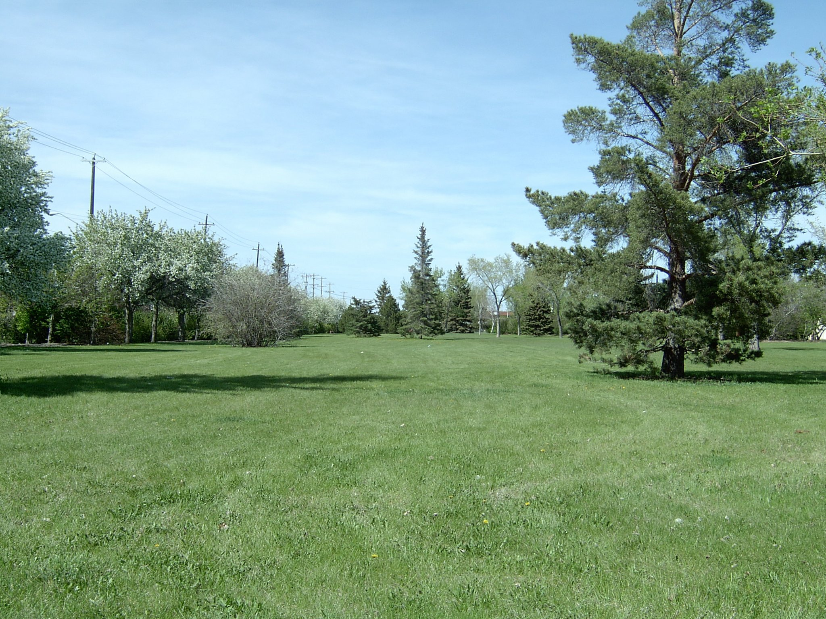

Slide 4
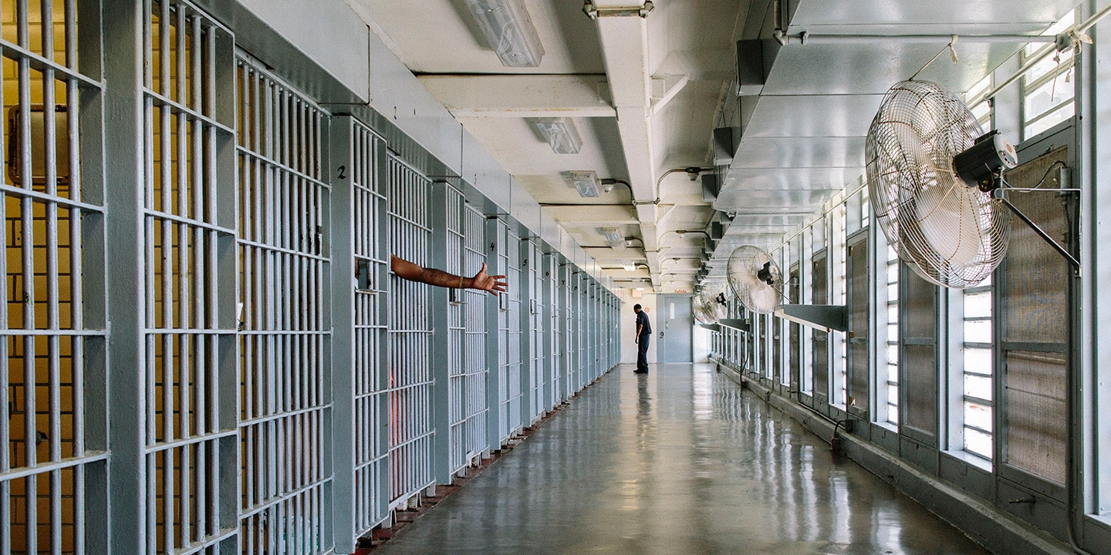

Slide 5
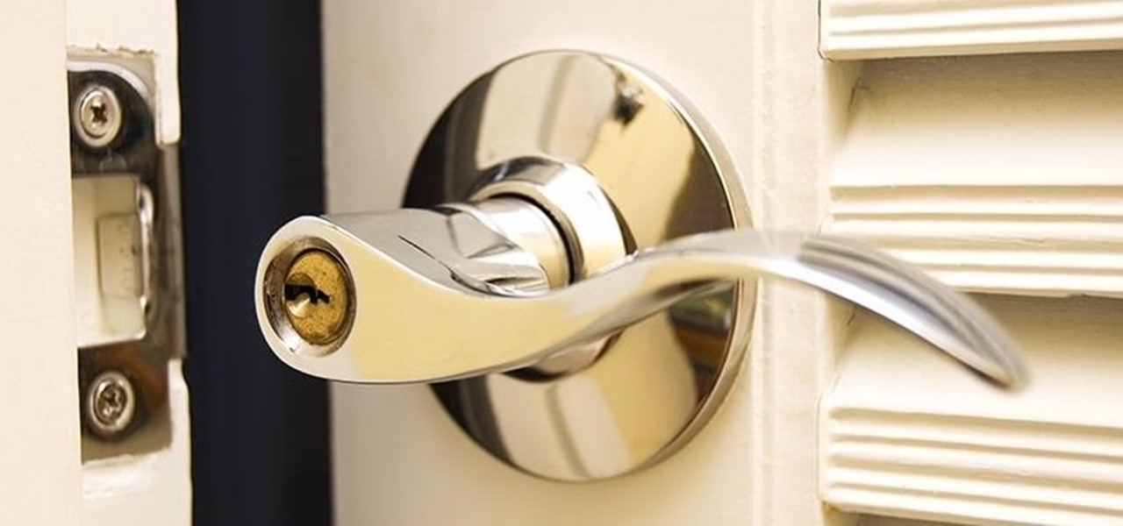

Slide 6
The Story of Mat Honan

Slide 8
What Happened with Mat
Amazon.com account compromised
Apple account compromised
Gmail broken into
Mac and iPhone wiped
Twitter account stolen
Could this happen to you? How?

Slide 9
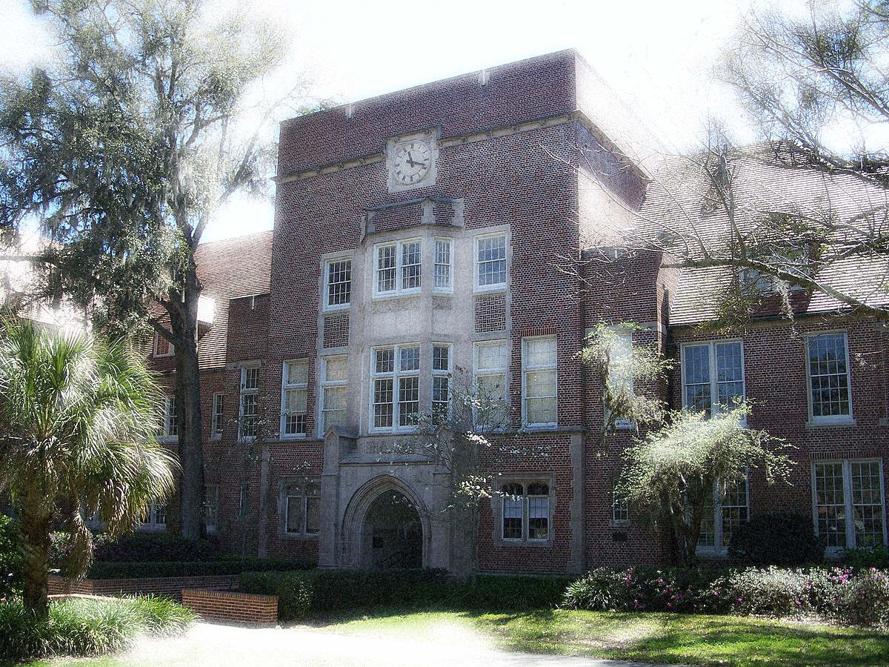
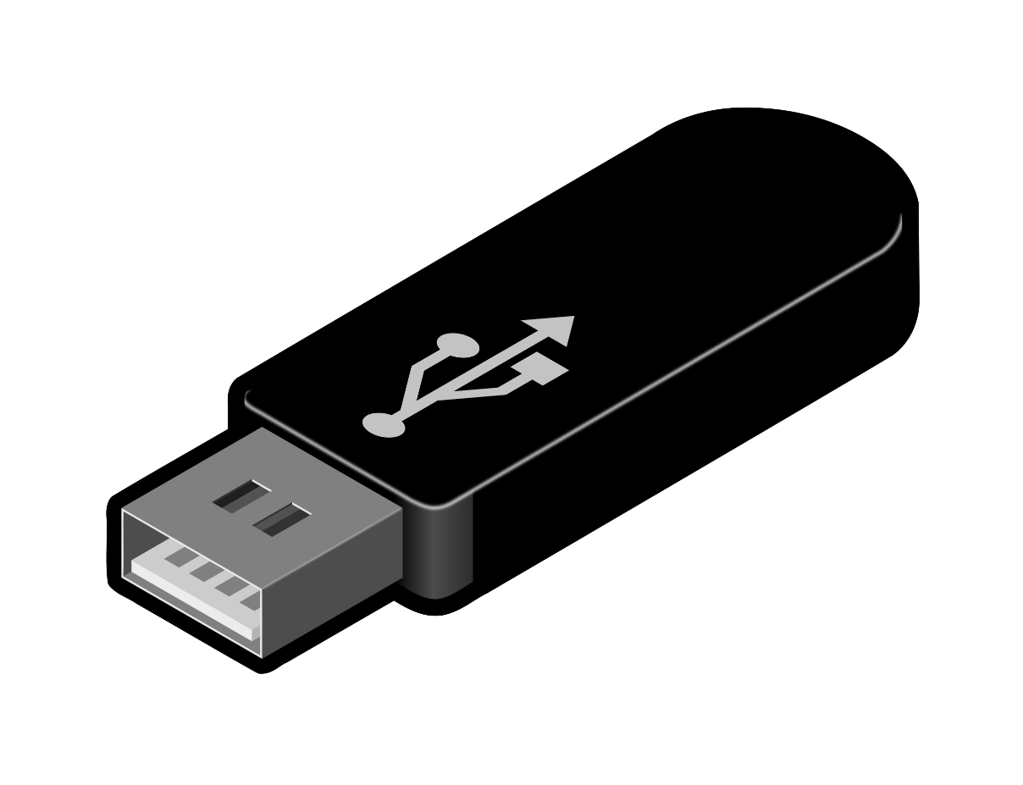

Slide 10
What We Are Going to Cover
Passwords
Multi-Factor Authentication
Security Questions
Phishing
Malware Prevention
Website Trustworthiness
Data Storage
Mobile Devices

Slide 11
25 Most Common Passwords of 2018
123456
password
1245678
qwerty
12345
123456789
letmein
1234567
football
iloveyou
admin
welcome
monkey
login
abc123
starwars
123123
dragon
passw0rd
master
hello
freedom
whatever
qazwsx
trustno1

Slide 13
Four Components of a Good Password
Upper case letters
Lower case letters
Numerals
Symbols
26
26
10
Approx. 20 depending on system

Slide 14
Poor Password Choices
Your Name
Family members’ names
Numbers easily connected to you
Dictionary words
Things identified with you
Pet names
Old passwords
Passwords from other places

Slide 16
Password Creation Techniques
Meaning based on phrase
First letter of each word
Passphrase
Four unrelated words, at least 20 characters
Randomly Generated
Muscle memory
Password database
“Ryan ran around in two circles talking about passwords!” ► Rrai2ctap!
kiwi deck firefly socket ► kiwideckfireflysocket
F3&_BJJdV-ve

Slide 17
Password Enhancement Techniques
“Haystacks” Method
Add a pattern of text to the front, middle, or end of your password
Number/symbol substitution
Substitute numbers and symbols for letters
Rrai2ctap! ► Rrai2ctap!.,.,.,.,.,
HappyVille► H@ppyV1ll3

Slide 18
The Hunt for the Perfect Password
Activity
1

Slide 19
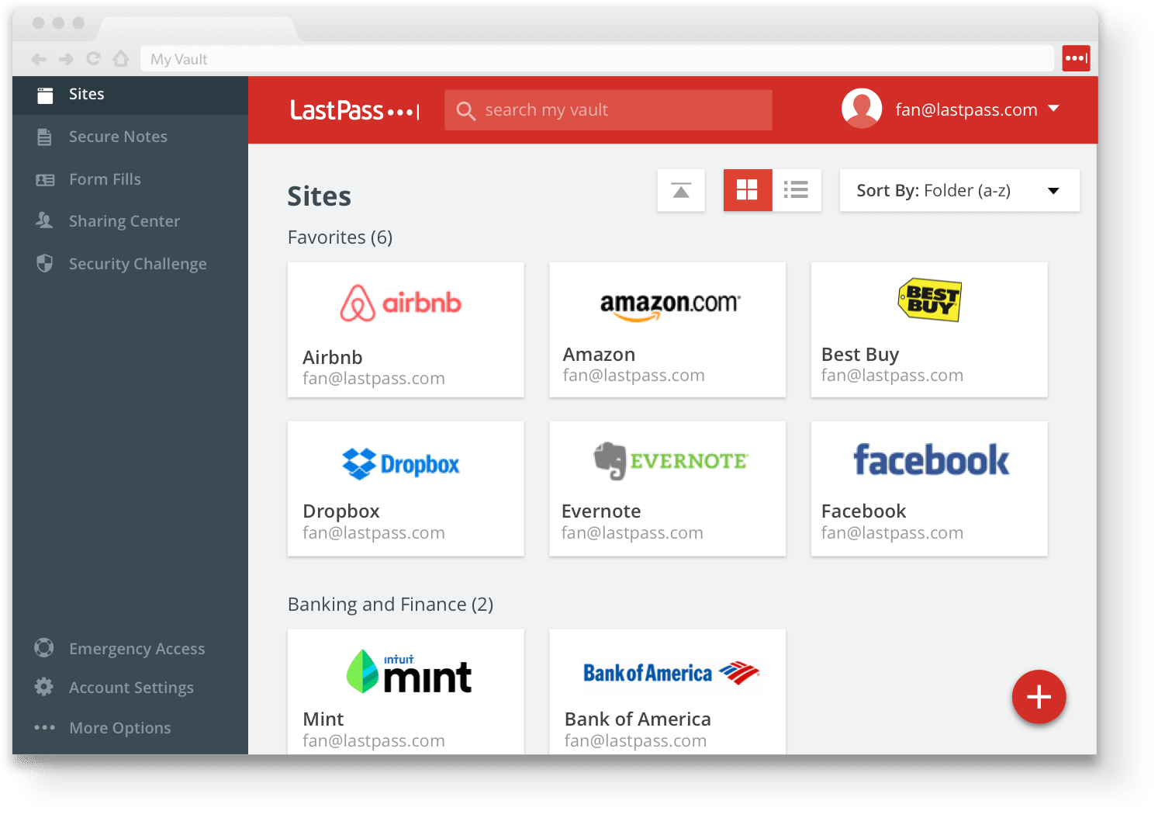

Slide 21
Multifactor Authentication
What you know
Password
What you have
Landline Phone
App
Who you are
Biometric
Facial recognition
Token
Text message
Eye scanning

Slide 22
Duo Authentication at UF

Slide 23
Security Questions Discussion
What are security questions?
How easy is it to find out the answer to one?
Can your group come up with the “perfect” security question?

Slide 25
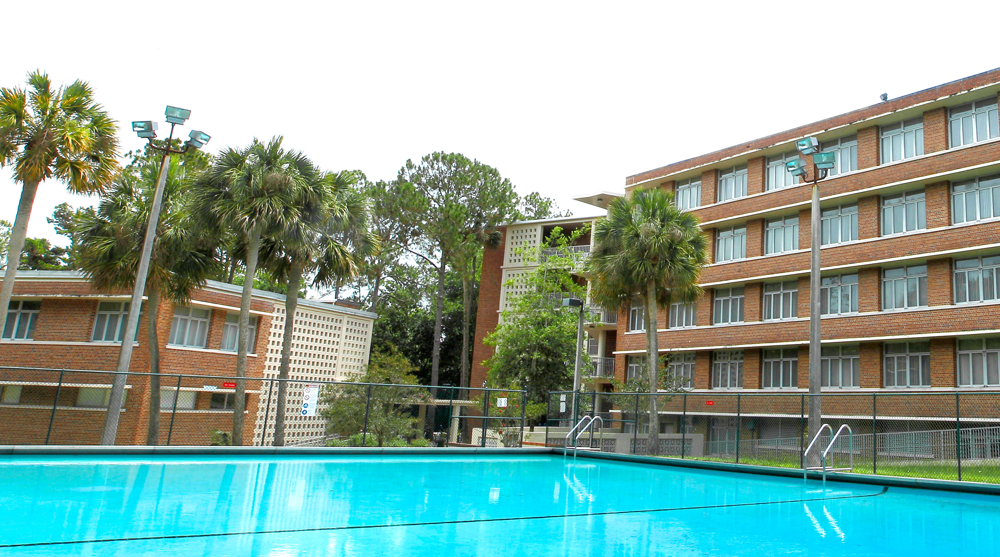
Sto
Story of the LinkedIn Scam in Student Affairs

Slide 27
How to Spot Phishing
Typos
Urgency
Call to Action
Unsolicited
Bad links
Too good to be true
Think about it…
Are you eligible to win the British lottery?

Slide 28
Jury Duty: Phishing or Not Phishing?
Activity
2

Slide 29
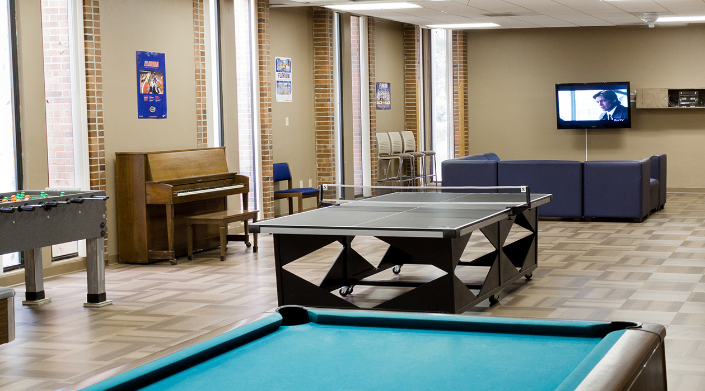
BREAK TIME

Slide 30
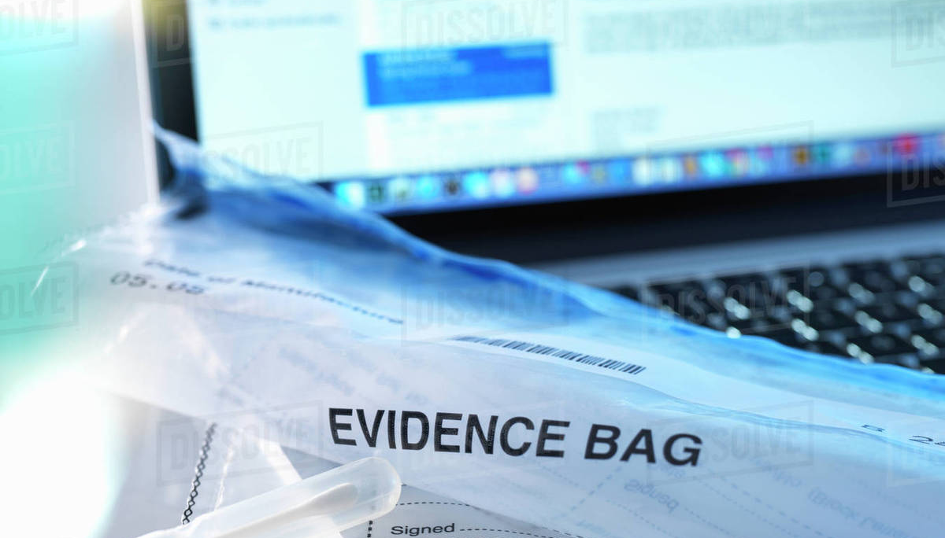
The Story of My Computer Being Taken Away by IT Prevention vs Reaction

Slide 31
What is malware?
Viruses/worms/bots
Trojan Horses
Rootkits
Where do you think the most malware infections come from? What are the motivations of malware authors?

Slide 32
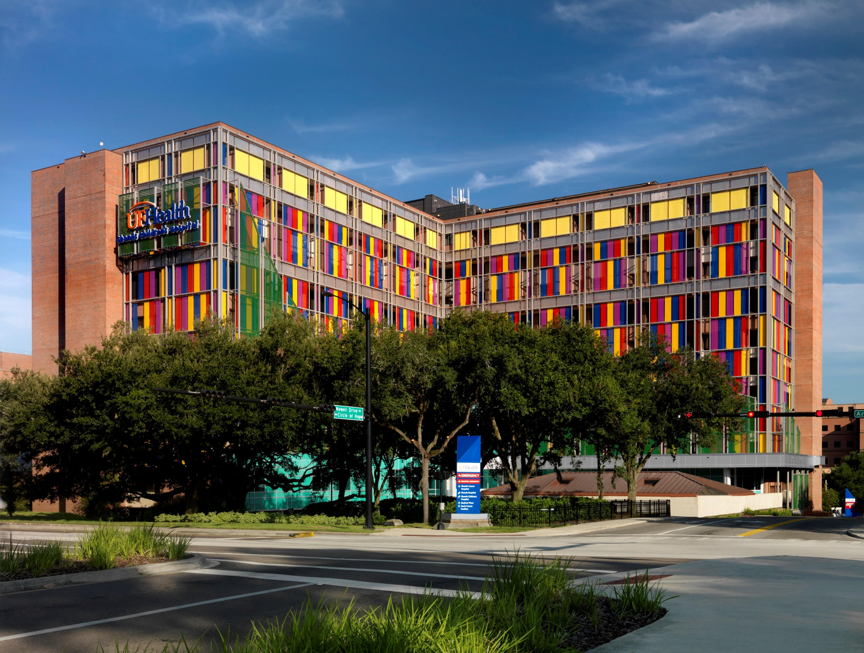
Story of the Hacked Hospital (no it wasn’t this one! ☺)

Slide 33
A Trip to the Computer Doctor
Activity
3

Slide 34
What happens when you get infected?
Click here to download Ryan’s Solitaire
FREE!

Slide 36
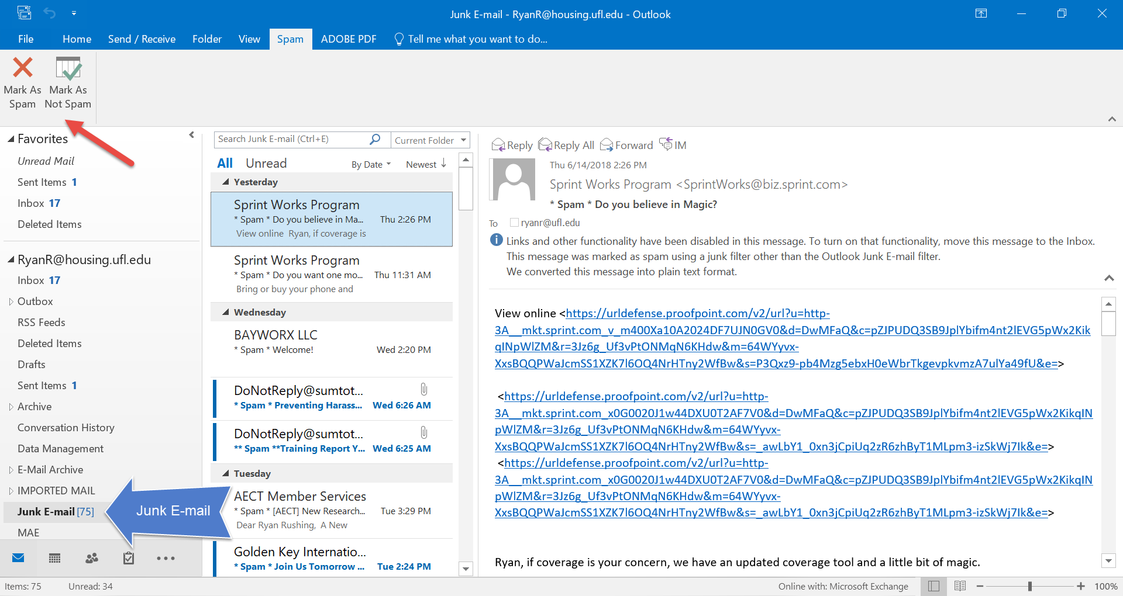

Slide 37
Safe Websites Discussion
How do you know whether or not it is safe to download something off a particular website?
What are some warning signs of an untrustworthy website?
What are some other ways you can stay safe on the web?

Slide 38
Safe Websurfing
Background check/reviews
HTTPS vs HTTP
Limit information on forms
Be skeptical
Be wary of ads
Bookmark important sites
Disable browser notifications
Avoid illegal and unscrupulous sites
WHAT AND WHERE

Slide 39
UF Data Definitions & Examples
Restricted
Student records
Credit card data
Sensitive
Employee data
Open
UF Directory
Course catalog
Social security numbers
Exams (questions and answers)
University regulations
Public websites

Slide 40
Storing Data @Work
OK
Not OK
UF Dropbox
SharePoint
Shared drives
UF File-Express
Flash drives or personal devices
Non-UF Dropbox
Google Docs
Local drive

Slide 41
Unlocking Your Mobile Device
No protection
Pattern unlock
4 digit PIN code
6 digit PIN code
Password
Finger scan
In your groups, discuss:
Which of the these is an acceptable form of security? How strong are they?
What if you have work email or files on your phone?

Slide 42
Securing Your Mobile Device
Background check on apps/reviews
App permissions
GPS tracking
Remote lock/wipe
WHAT and WHERE
or another anti-virus app

Slide 43
Creating Your Personal Security Plan
Activity
4

Slide 44
Computer Security Bootcamp @Home
Protecting personal PC
Keeping your computer updated
Malware cleanup
Spam prevention
Securing Mobile Devices
Routers
Data Backup
Identity Theft
Online Safety
Privacy
Next session:
TBD

Slide 45
Ryan J. Rushing Coordinator for Learning and Development
rrushing@ufsa.ufl.edu x10110

